Slide 1

Cyclistic bike share capstone project
By Asim Abdalla Osman
Last updated: 6/9/2024

Slide 2
Contents
Introduction
Business Task
Data
Analysis
Summery
Recommendtions

Slide 3
Introduction
In 2016, Cyclistic launched a successful bike-share offering. Since then, the program has grown to a fleet of 5,824 bicycles that are geotracked and locked into a network of 692 stations across Chicago. The bikes can be unlocked from one station and returned to any other station in the system anytime.
pricing plans: single-ride passes, full-day passes, and annual memberships. Customers who purchase single-ride or full-day passes are referred to as casual riders. Customers who purchase annual memberships are Cyclistic members.

Slide 4
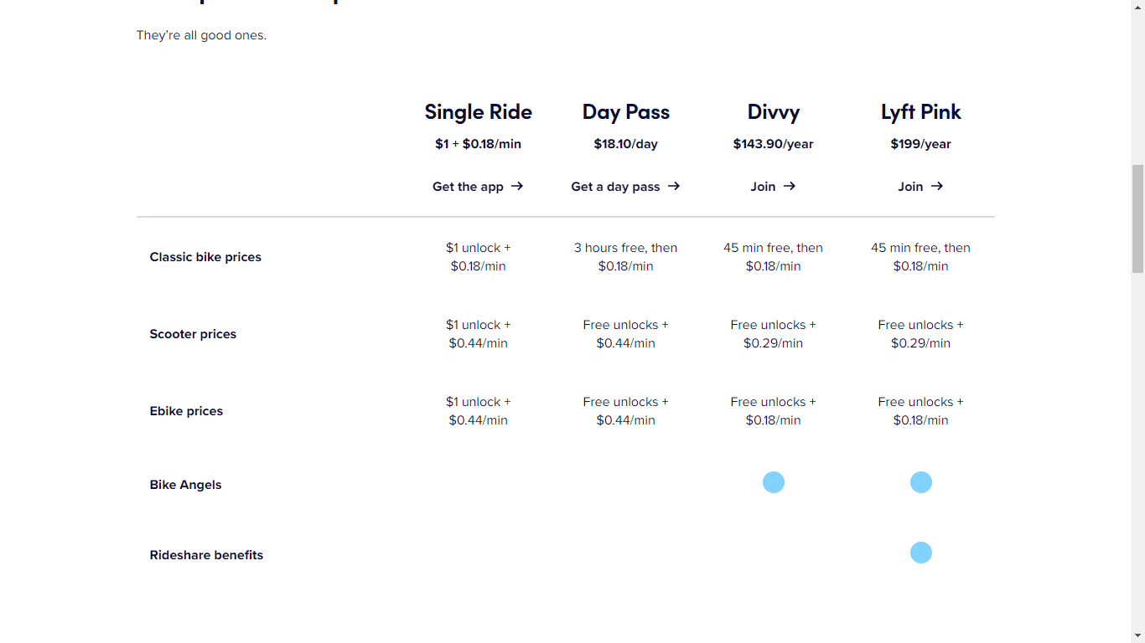
Pricing Plans

Slide 5
Business Task
Convert Casual users to members, by understanding how casuals use Cyclistic differently, and create a marketing campaign that target them.

Slide 6
Data
the datasets are appropriate and will enable us to answer the business questions. The data has been made available by Motivate International Inc. under this license.
data-privacy issues prohibit us from using riders’ personally identifiable information. This means that we won’t be able to connect pass purchases to credit card numbers to determine if casual riders live in Cyclistic service area or if they have purchased multiple single passes.

Slide 7
Analysis

Slide 8
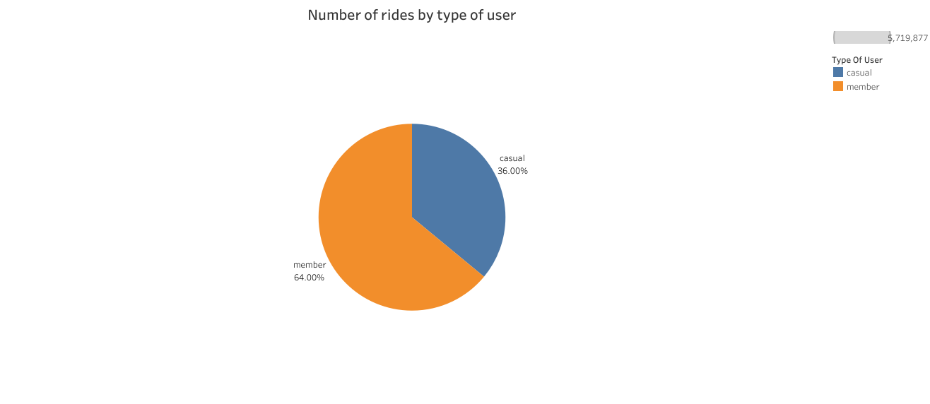
Insight #1:
Number of rides taken by Members is 31% more than rides taken by Casual users.

Slide 9
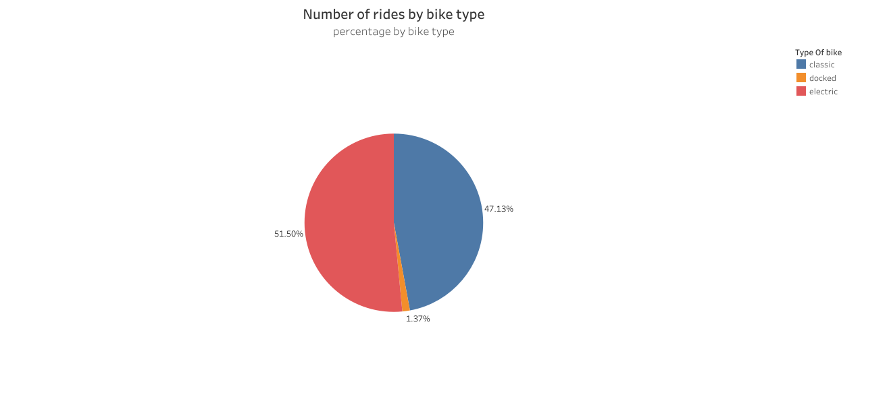
#insight #2:
Electric bikes are the most used bikes
Docked bikes are the least used bikes

Slide 10
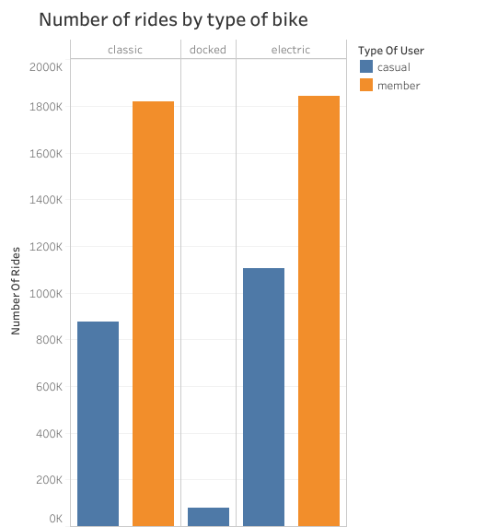
Insight #3:
Casual riders tend to use e-bikes more than classic bikes
Docked bikes are used by casual users exclusively

Slide 11
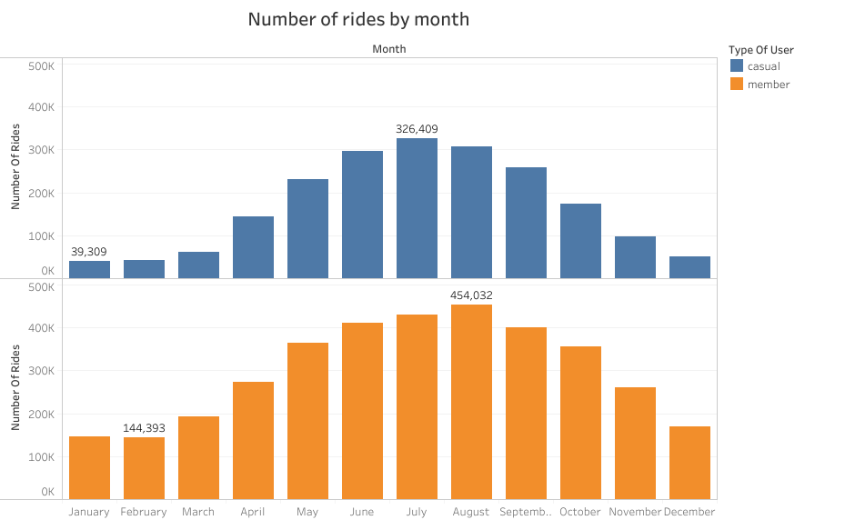
Insight #4:
Number of rides peaks in summer months and decrease in winter

Slide 12
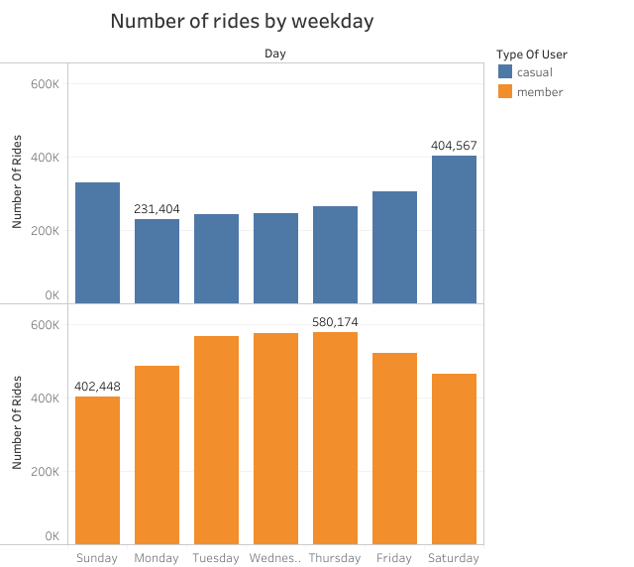
Insight #5:
Casuals tend to ride more on weekends.
Members ride more on the weekdays.

Slide 13
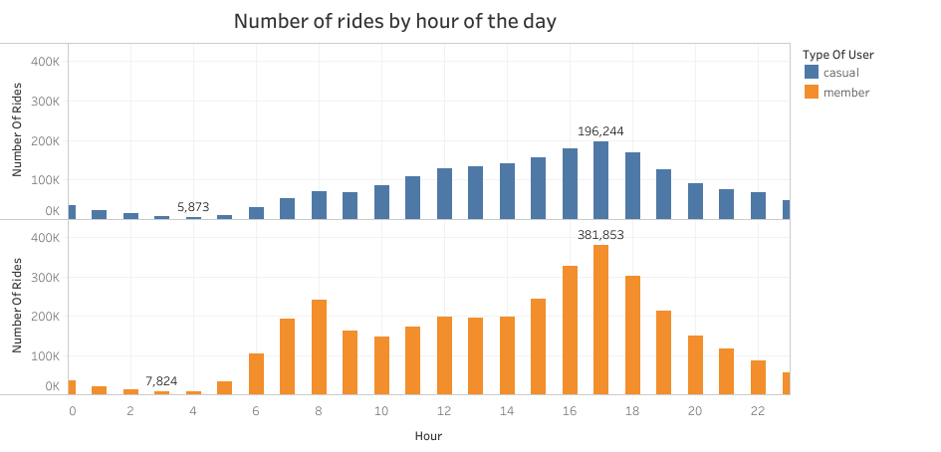

Slide 14
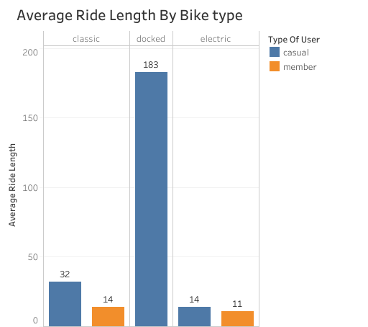
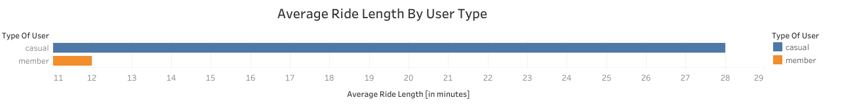
Insight #6:
Casuals tend to ride for longer durations than members.

Slide 15
Summery
Number of rides taken by Members is 31% more than rides taken by Casual users.
Electric bikes are the most used bikes, Docked bikes are the least used bikes.
Casual riders tend to use e-bikes more than classic bikes, Docked bikes are used by casual users exclusively.
Number of rides peaks in summer months and decrease in winter
Casuals tend to ride more on weekends, Members ride more on the weekdays.
Casuals tend to ride for longer durations than members

Slide 16
Recommendtions
Increase the time limit for the annual membership to meet the casual users need.
Create new offers for weekend and holidays.
Promote the E-bikes more effectively.

Slide 17
Thank you

